Slide 1

The Best Location
For A New
Opera
Company

Slide 2

The premise:
Where are the best existing and emerging markets for Opera to create a new traveling Opera Company that takes advantage of existing patterns in these markets?
This study is designed to engage and inform opera lovers, regardless of their level of experience, making it accessible to a wider audience interested in the art form’s growth and future.

Slide 3

The recommendation is to create a traveling Opera Company:
Use well-established opera hubs during “peak season”:
Italy and Austria
Take the same productions to emerging markets during “off-peak seasons”:
Sweden, the Netherlands, Poland, Estonia, and Latvia

Slide 4
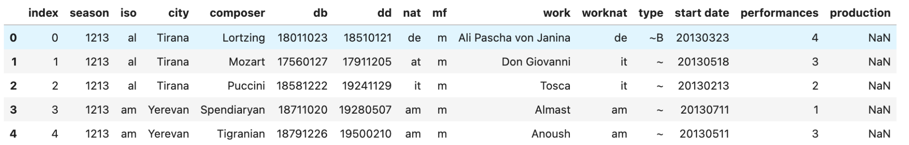
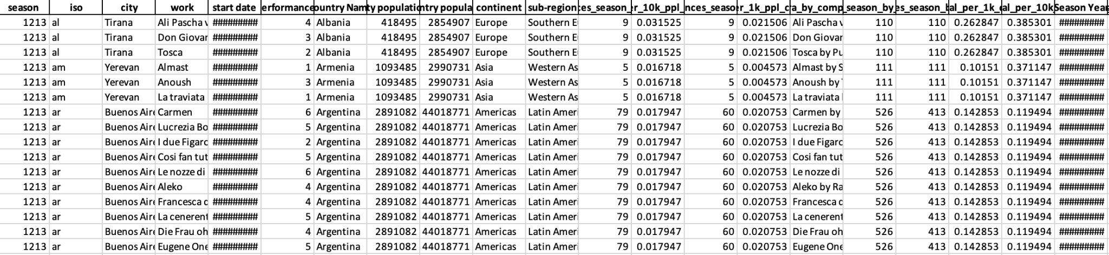
How the data started:
How the data ended:

Slide 5
Data Wrangling:
Merged Population Data per City and Per Country
Added Country Name, Continent and Sub-regions to data
Had to manually update cities with multiple spellings from original dataset that did not match with merged dataset
US cities needed to be manually cleaned due to multiple states having cities with the same names.

Slide 6
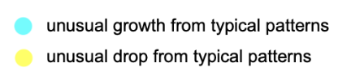
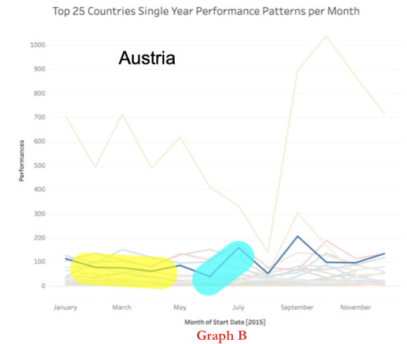
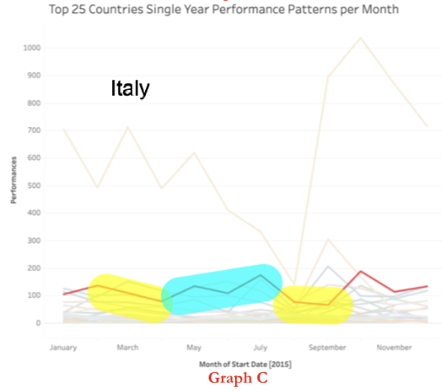
Exploratory Data Analysis (EDA)
These graphs highlight the unique seasonality in Austria and Italy compared to the rest of Europe. This inverse seasonality presents an opportunity for targeted market investment during peak seasons in other countries, while also providing time to explore emerging markets during traditional off-peak seasons, avoiding conflicts with existing opera companies."

Slide 7
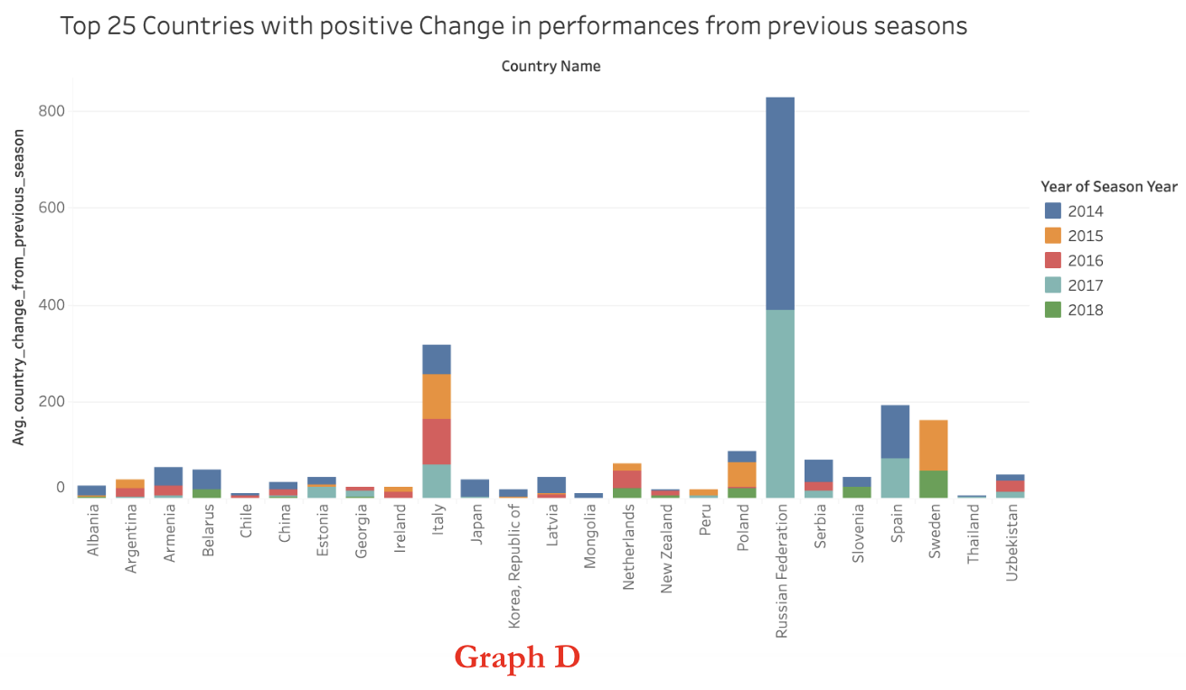
EDA continued

Slide 8
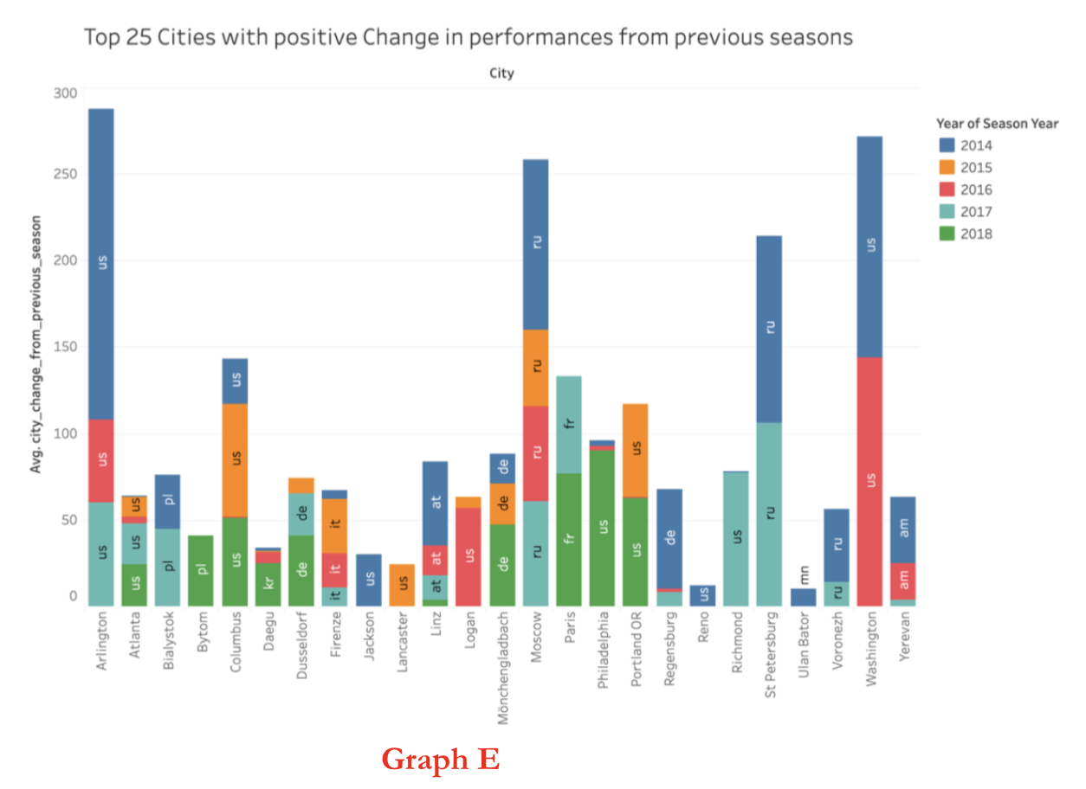
EDA continued

Slide 9
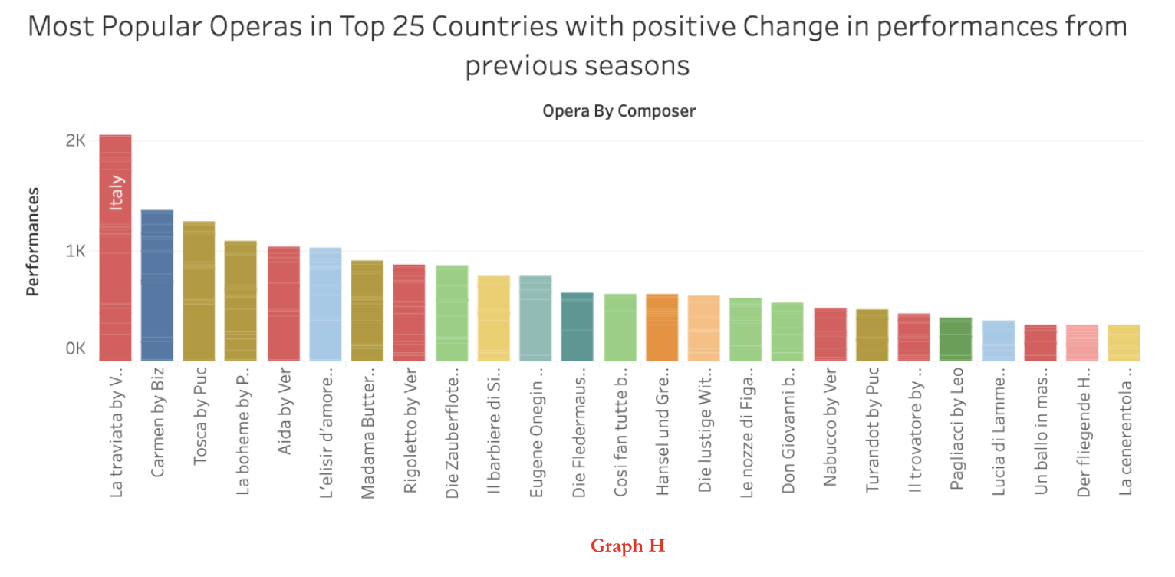
EDA continued
The same operas are in the Top 25 for performed operas with Top 25 Cities (correlating with Graph E), albeit in a different order.

Slide 10
Pre-Processing and Training Data
Deleted rows not being used for prediction ie. composer, work, composer’s data of birth, composers date of death etc.
Transformed start date into separate datetime objects ie. Month, Day of Week, Year etc.
Applied one hot encoding for categorical features like Month and Day of Week
Used linear model to fill in empty values for the change in performances from previous seasons for countries and cities

Slide 11
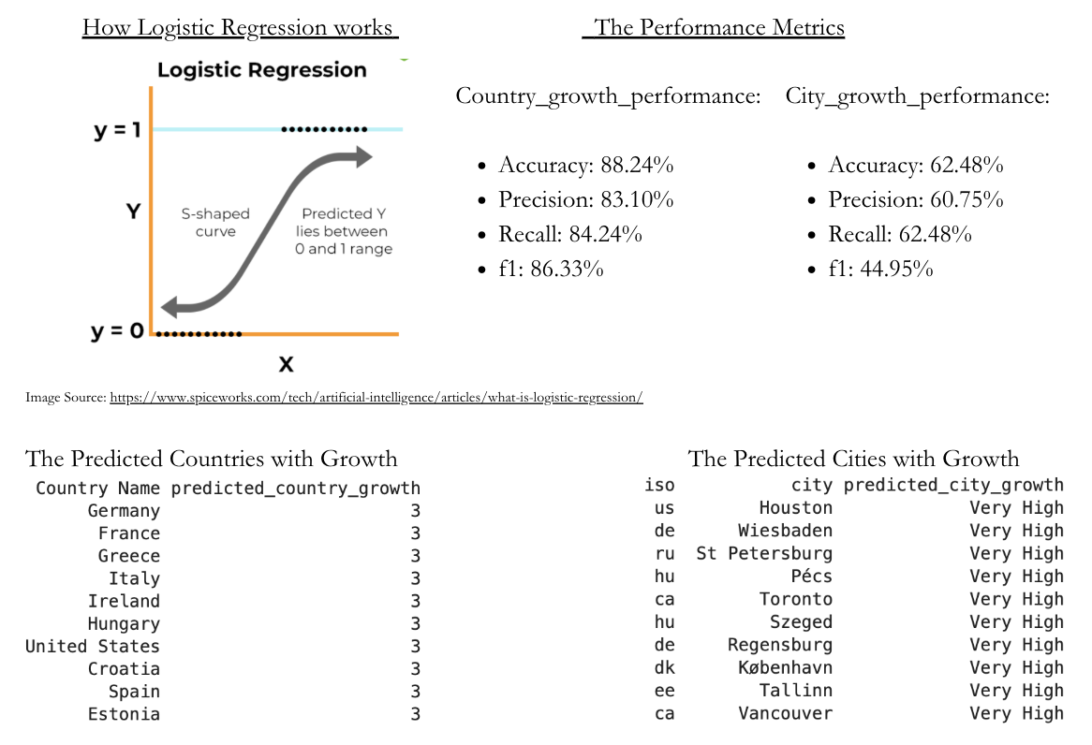
Modeling - Logistic Regression

Slide 12
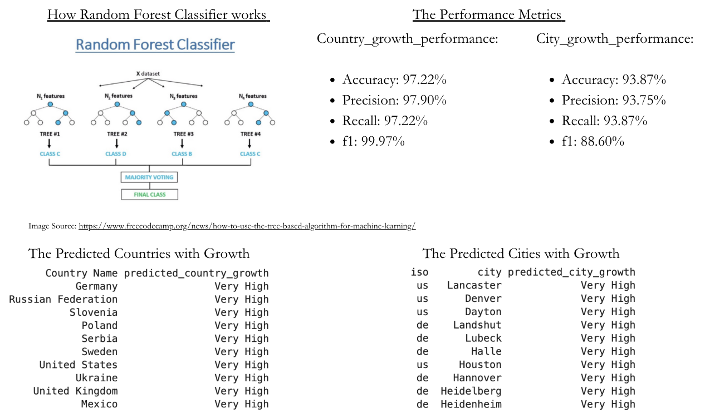
Modeling - Random Forest Classifier

Slide 13
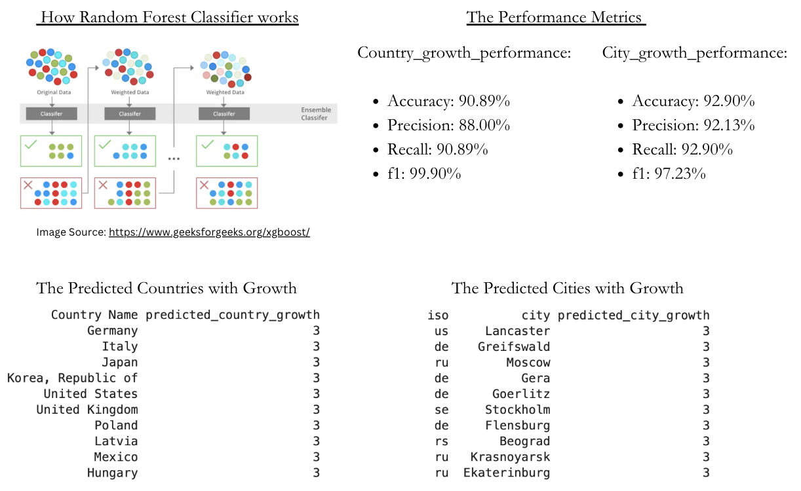
Modeling - XGBoost Classifier

Slide 14
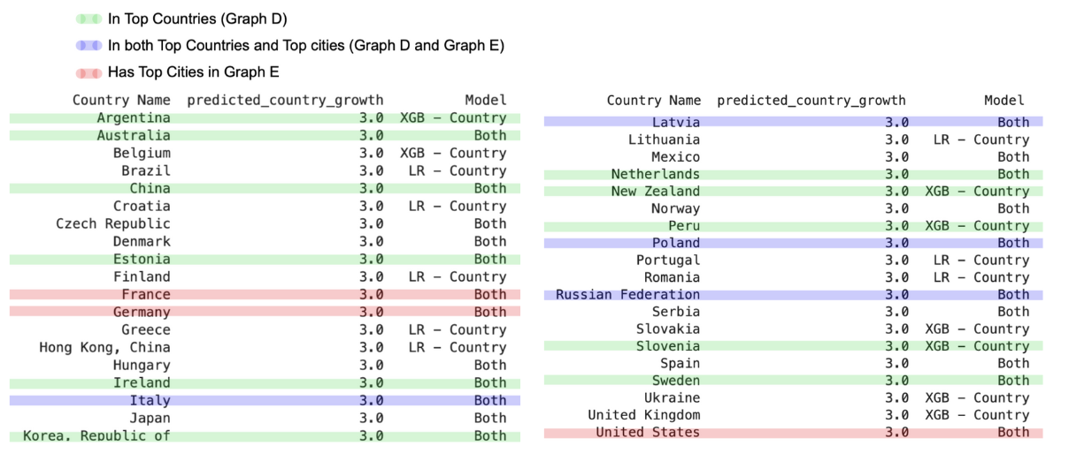
Conclusions:
This chart reaffirms the recommendations from the beginning of the presentation.

Slide 15

Questions?

